Slide 1
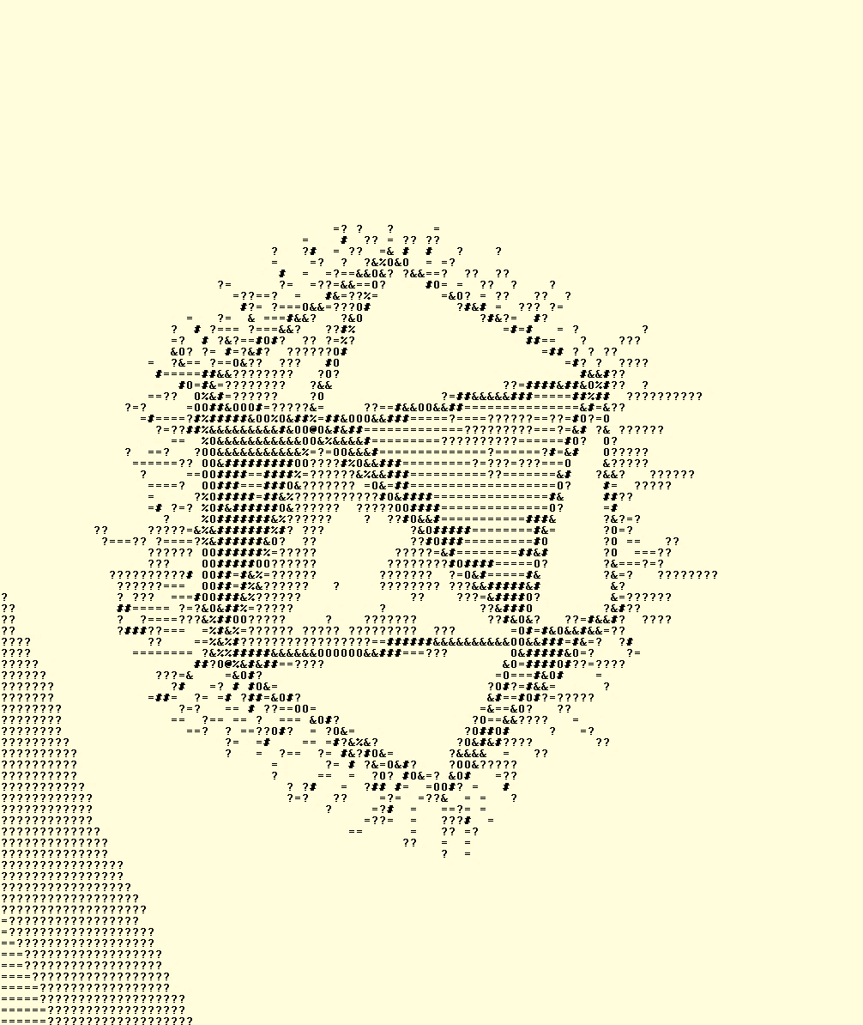

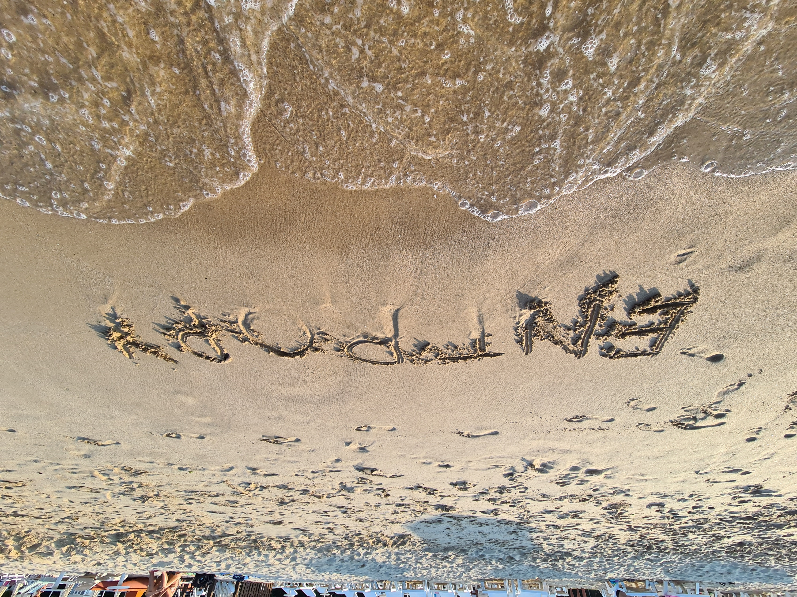
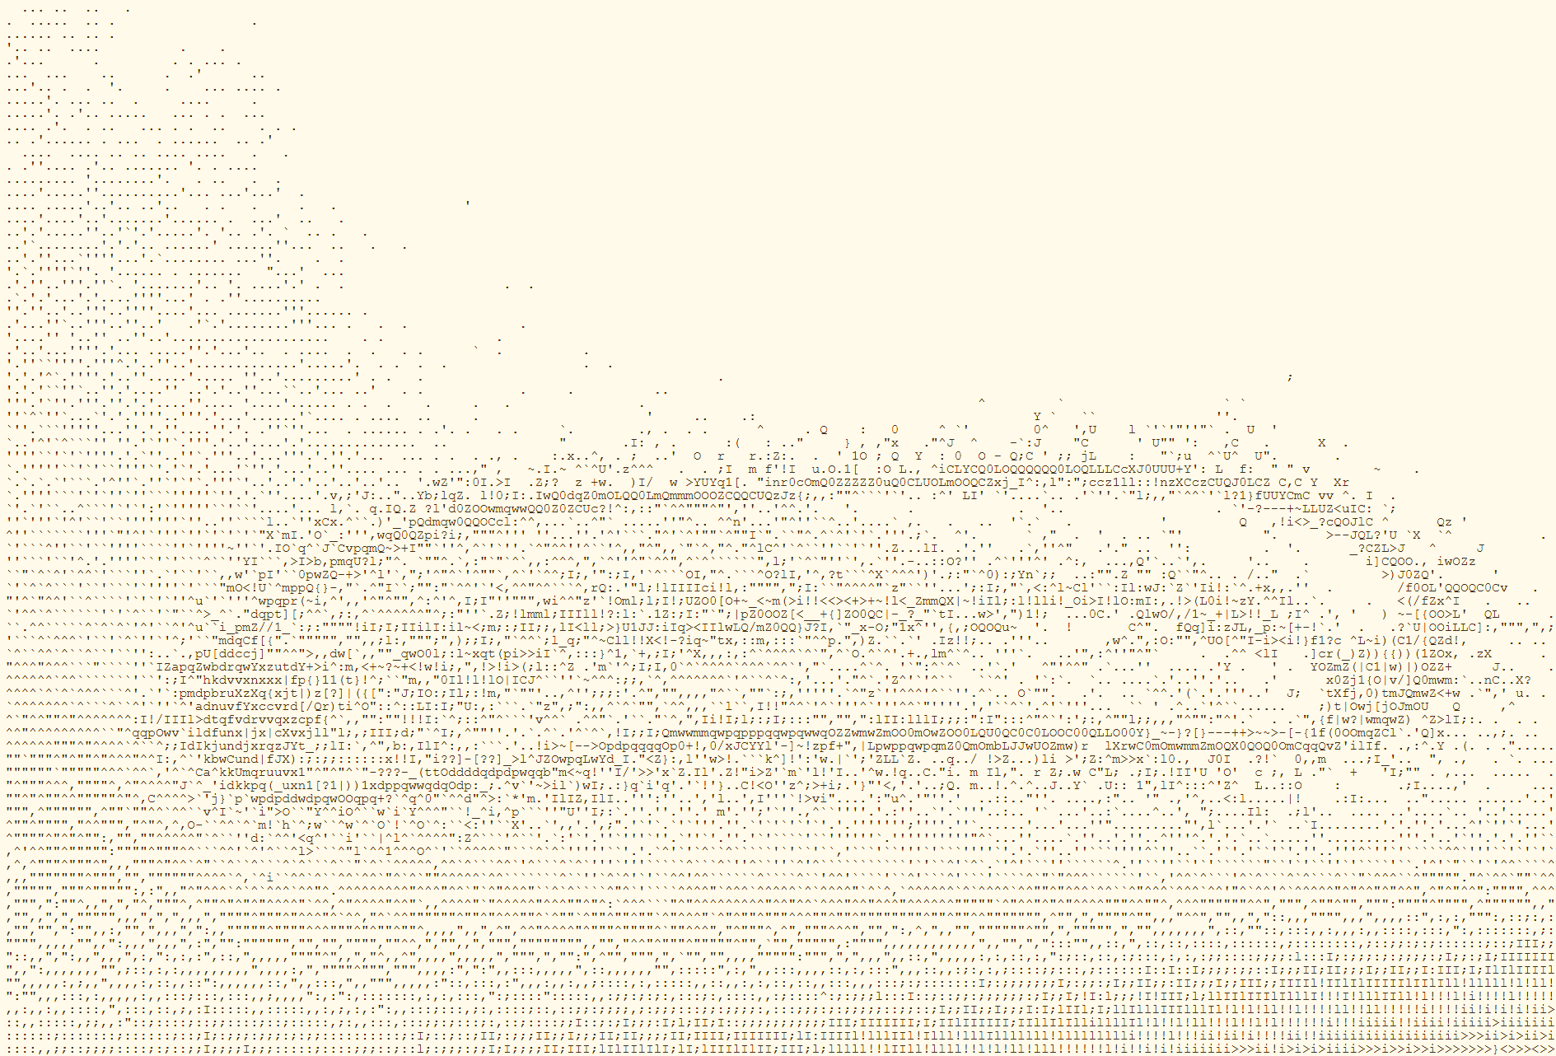
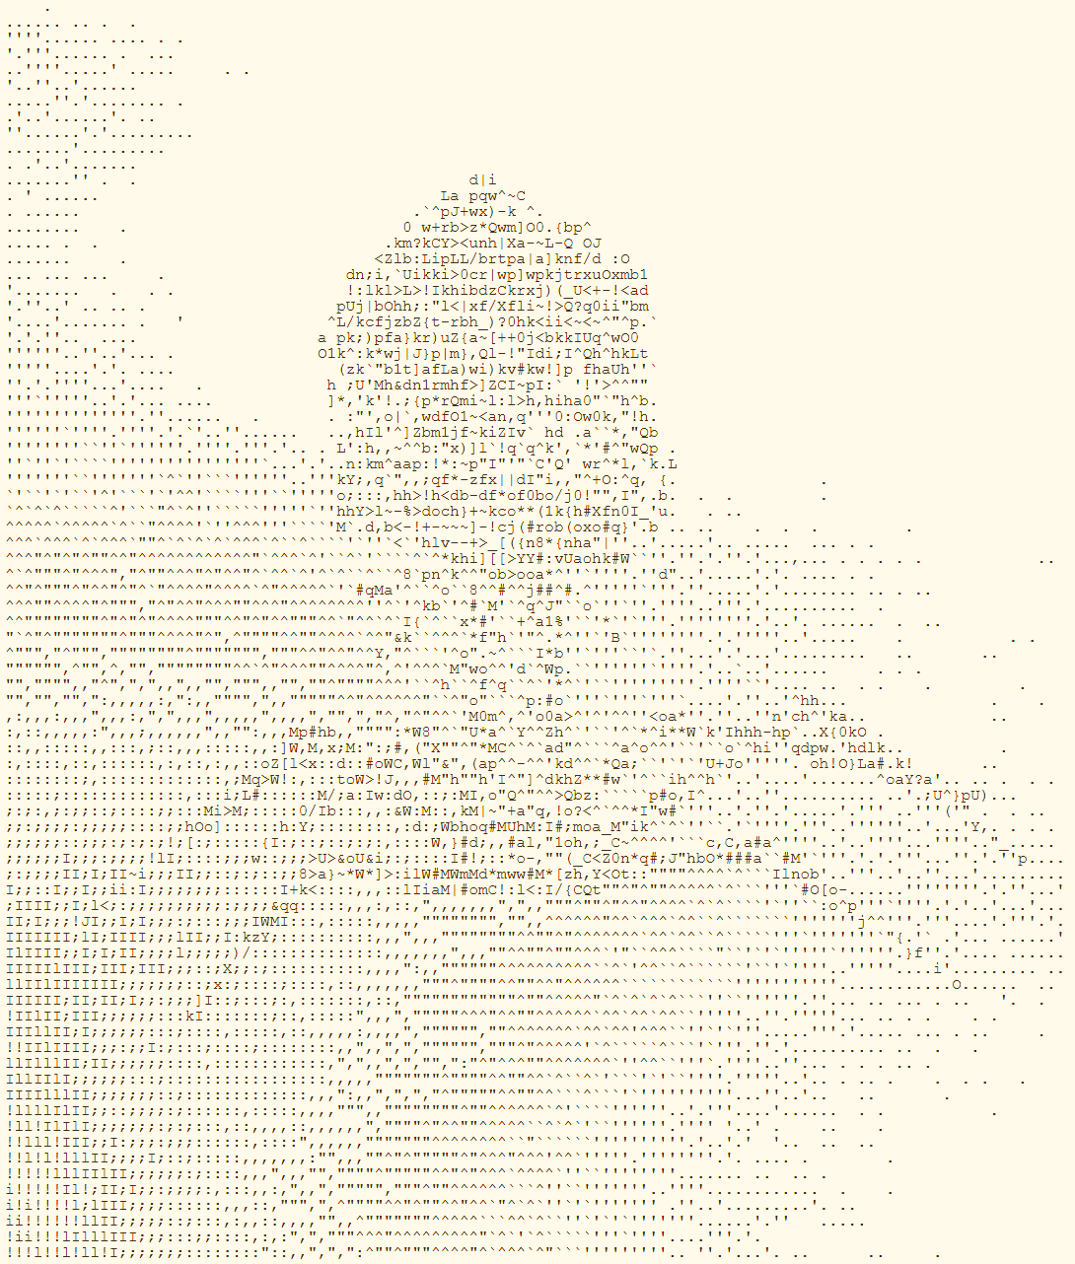
Art = {0?=#&%}

Slide 2

From entropy to art and back. The word "entropy" is written on the beaches of Golden Sands in Bulgaria. The word written in the sand indicates low entropy, which is quickly increased by noise represented by the waves of the Black Sea. The top-right panel shows a viral capsid close to a cell wall, which is portrayed by ASCII art.
Paul A. Gagniuc. An Introduction to Programming Languages: Simultaneous Learning in Multiple Coding Environments. Synthesis Lectures on Computer Science. Springer International Publishing, 2023, pp. 1-280.

